Slide 1
School of Geography and Geology
McMaster University
Advanced Topics in Spatial Statistics
Session 17
Area Data III

Slide 2
This session
Modeling area data
  Non-spatial regression models
More data transformations
Spatial models
  Spatial errors model
  Mixed regressive autoregressive model
  Pure autoregressive
  Moving averages model

Slide 3
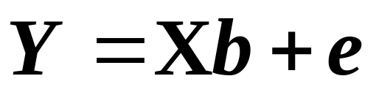
Example
Modeling area data
  Non-spatial regression
    Variables can be spatial
    Variables may be autocorrelated
    Assumes that there is no spatial autocorrelation
  Multiple regression

Slide 4
Non-spatial Regression
Usual assumptions
  Constant variance
  Independence
  Normality

Slide 5
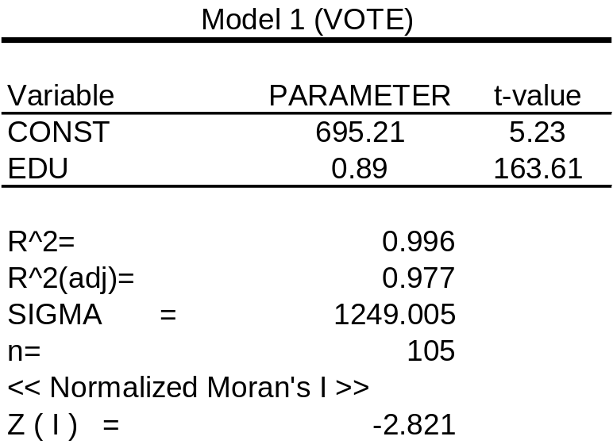
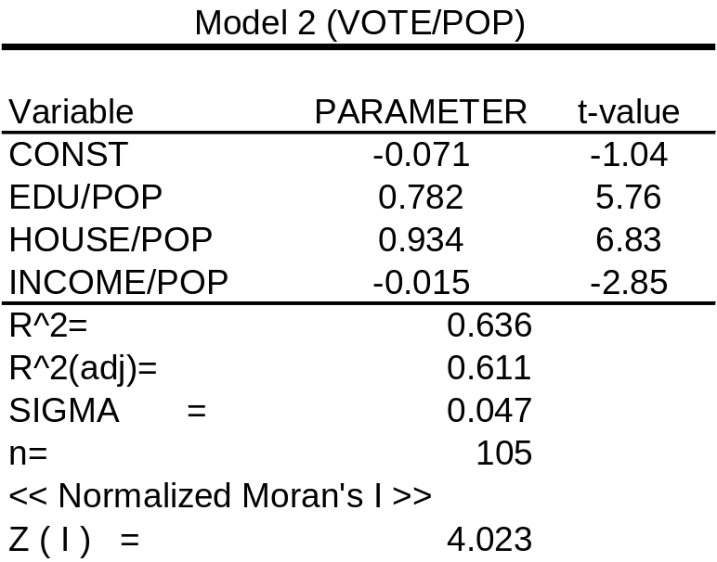
Non-spatial Regression
Two models: totals and proportions
Normality? No
Constant variance? No
Normality? Yes
Constant variance? Yes

Slide 6
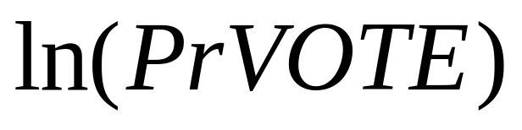
Modeling Area Data
Data transformations
  Logarithm of proportional voter turnout:
  Correlation coefficients
  Model
  Analysis of residuals

Slide 7
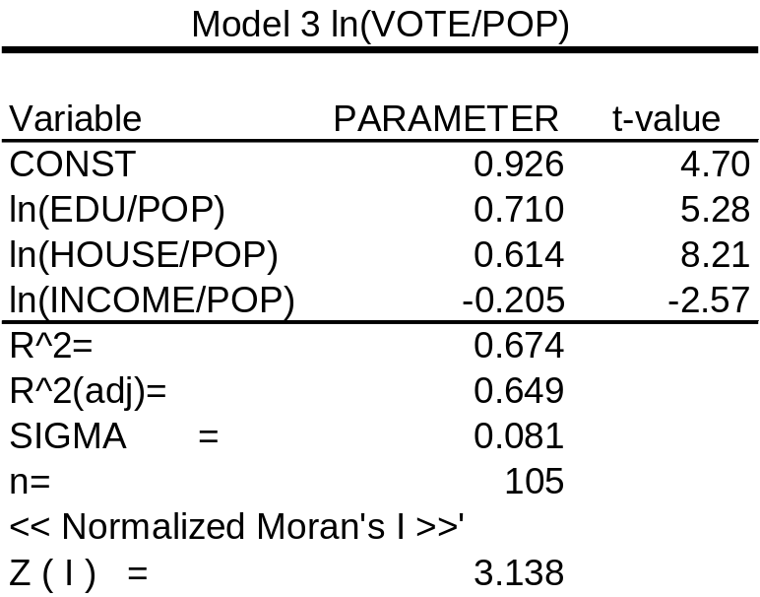
Variable Transformations
Taking logarithms:
Normality? No
Constant variance? Yes

Slide 8
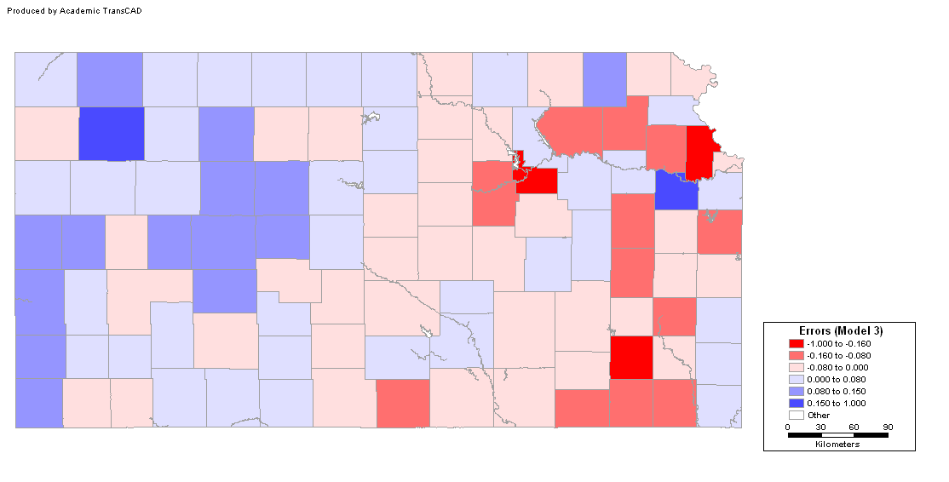
Analysis of Residuals
Are errors independent?

Slide 9
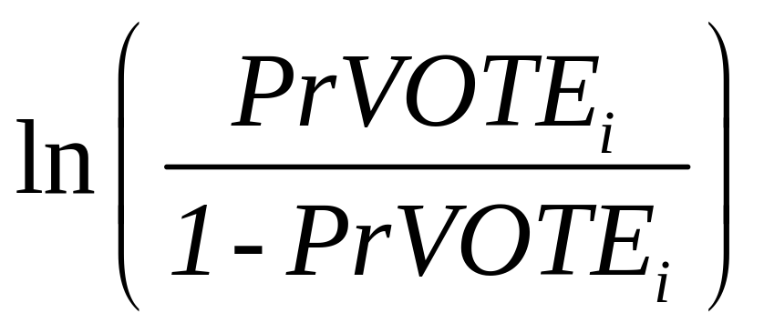
Variable Transformations
Modeling proportions
  Logistic transform (generalized linear model – slightly more advanced material)

Slide 10
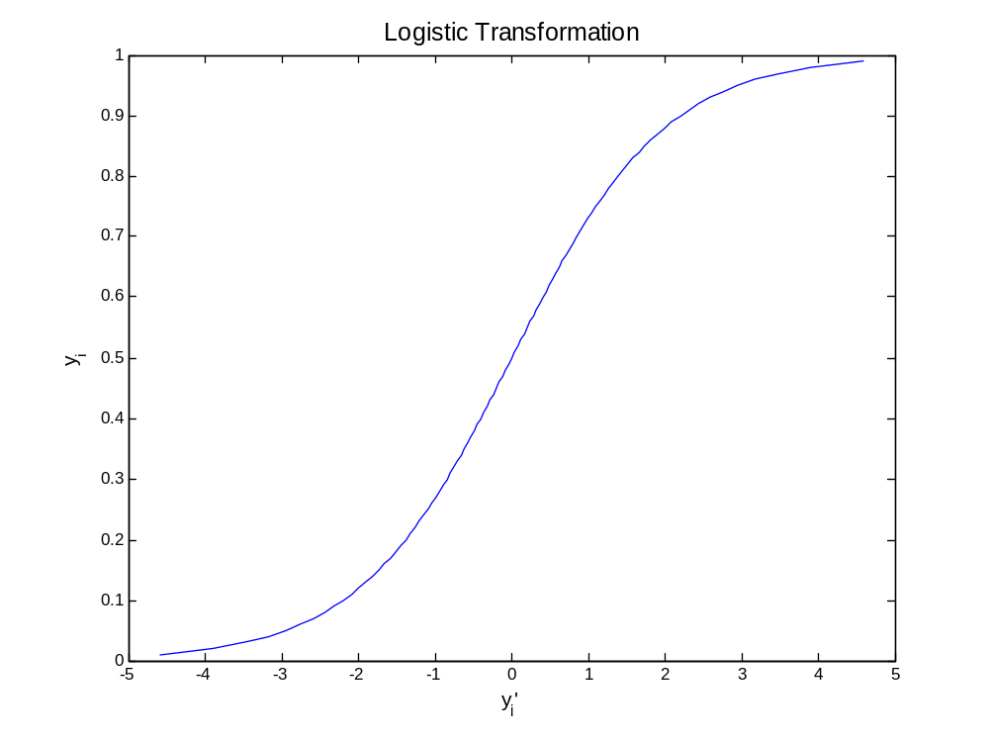
Variable Transformations
Logistic transform

Slide 11
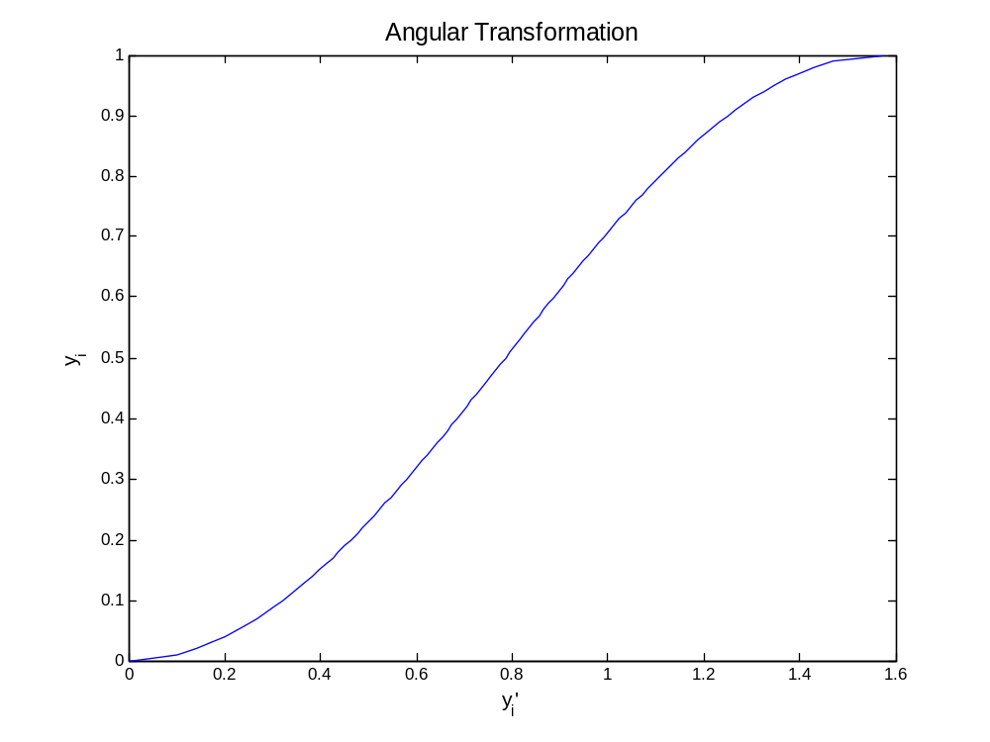
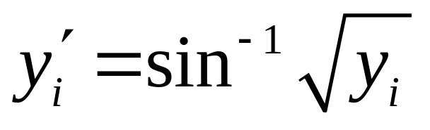
Variable Transformations
Angular transformation

Slide 12
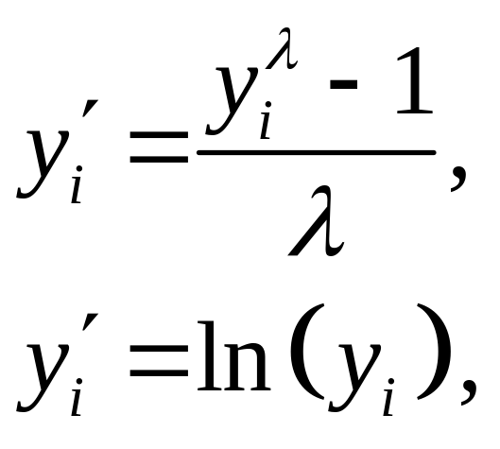
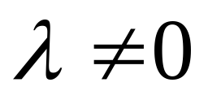
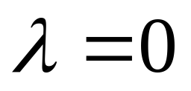
Other Data Transformations
Box-Cox
Count data:
  Poisson distribution
  Logarithmic

Slide 13
Non-spatial Regression
Data transformations may help to reduce problems with the residuals + increase interpretability
In the example: All three models show residual error pattern (error autocorrelation)
Spatial regression models

Slide 14
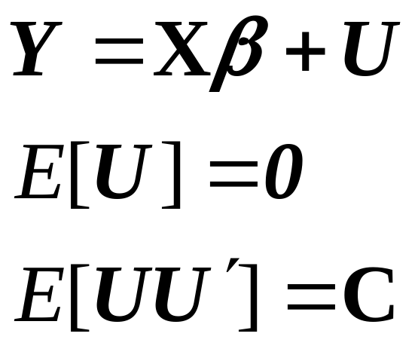
Spatial Regression Models
Objective:
  Testing for and estimating regression models that incorporate spatial effects
Recall GLS

Slide 15
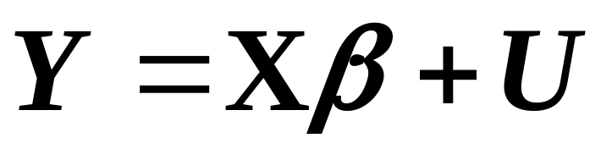
Spatial Regression Models
Generalized Least Squares
  2nd order effects?
  Questionable assumption of stationarity of 2nd order
  Distance measures?

Slide 16
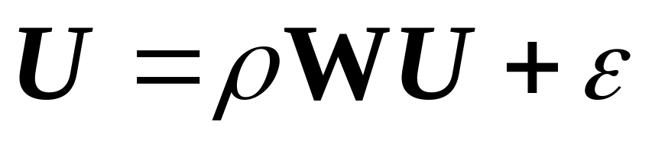
Spatial Regression Models
Autocorrelated errors model
Non-spatial part
Spatial part (residual pattern)

Slide 17
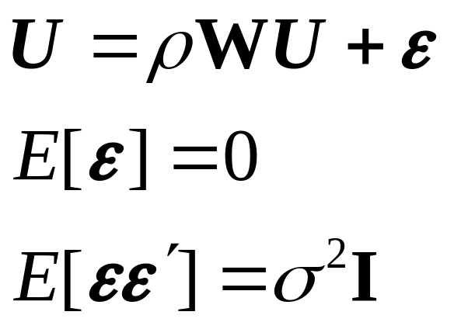
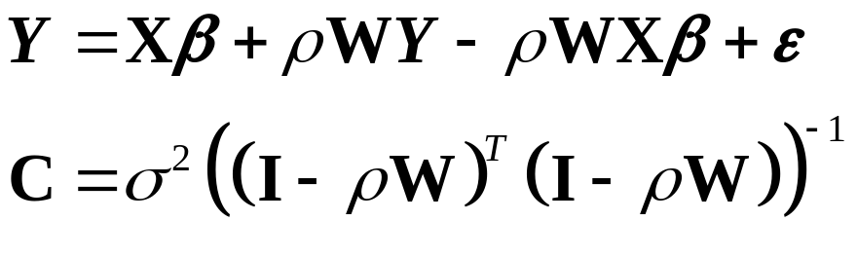
Autocorrelated Errors Model
  Rewriting:

Slide 18
Estimation of the Spatial Model
OLS estimation not useful
  If 0 < ρ < 1: standard errors for coefficients will tend to inflate significance of regression. Fit spatially differenced form by OLS.
  If -1 < ρ < 0: Reverse – OLS on original values.
  Alternatively – regress on sequence of different ρ values.

Slide 19
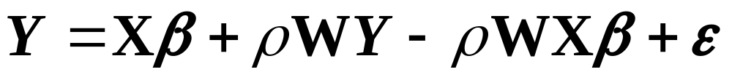
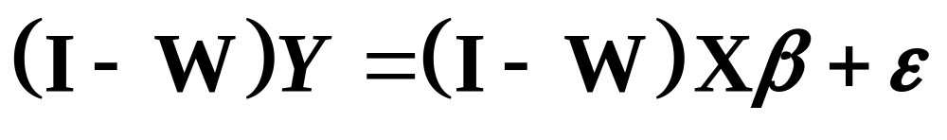
Estimation of the Spatial Model
Naïve approach
  ‘Guess’ a value, i.e., ρ = 1
  Spatial Differencing

Slide 20
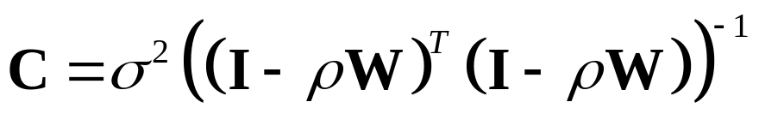
Estimation of the Spatial Model
Maximum likelihood estimation of β and ρ
Assumptions:
  y_{i} are observations on n random variables Y, jointly normally distributed with Mean = Xβ and Covariance matrix C, where

Slide 21
Estimation of a Spatial Model
Maximum likelihood estimation of β and ρ
What is the maximum likelihood function?

Slide 22
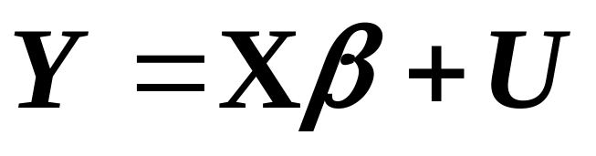
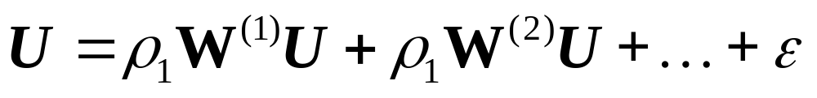
Alternative Spatial Models
Lag models

Slide 23
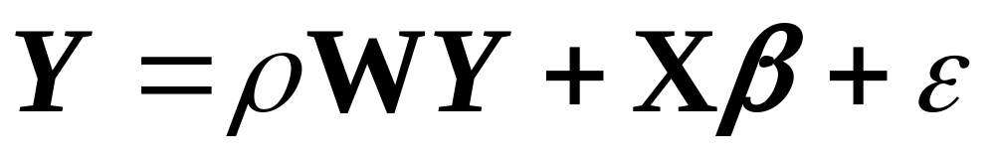
Alternative Spatial Models
Mixed regressive autoregressive
Spatial part
Non-spatial part

Slide 24
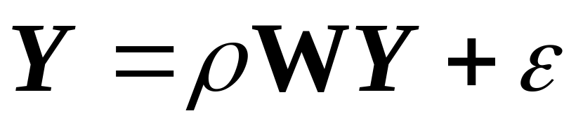
Alternative Spatial Models
Pure autoregressive
Spatial part

Slide 25
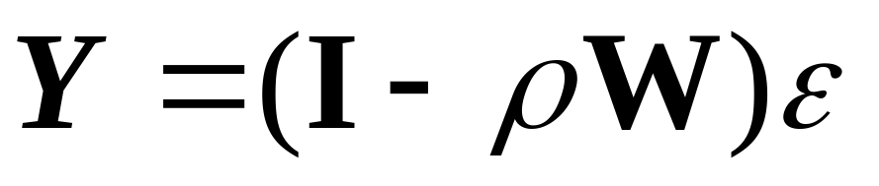
Alternative Spatial Models
Moving average model (map pattern)
Spatial part

Slide 26
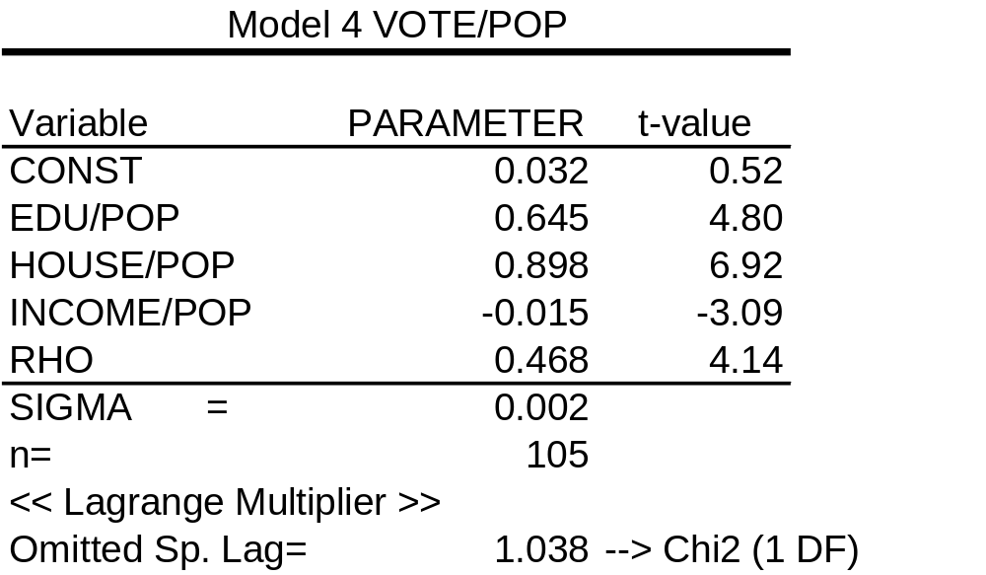
Spatial Regression
Fit autocorrelated errors model

Slide 27
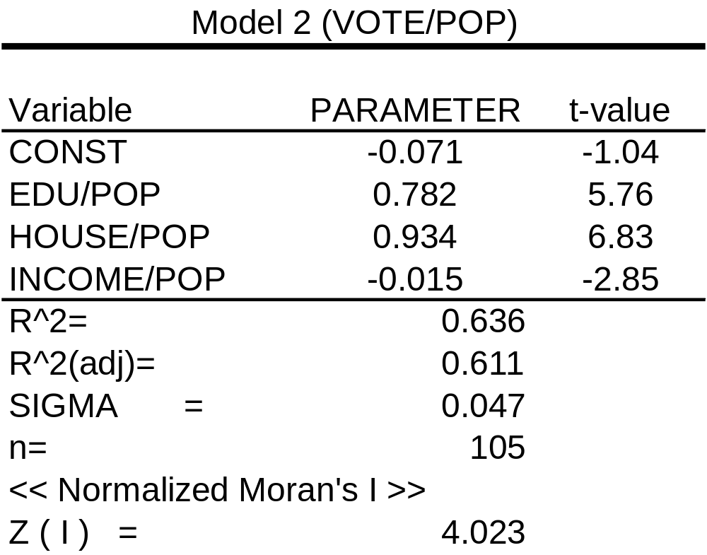
Example
Model 2

Slide 28
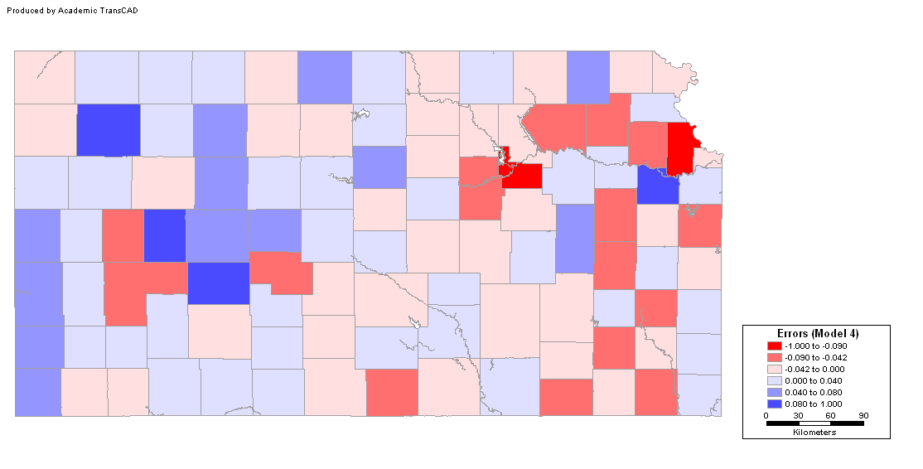
Analysis of Residuals
Are errors independent? Model 4

Slide 29
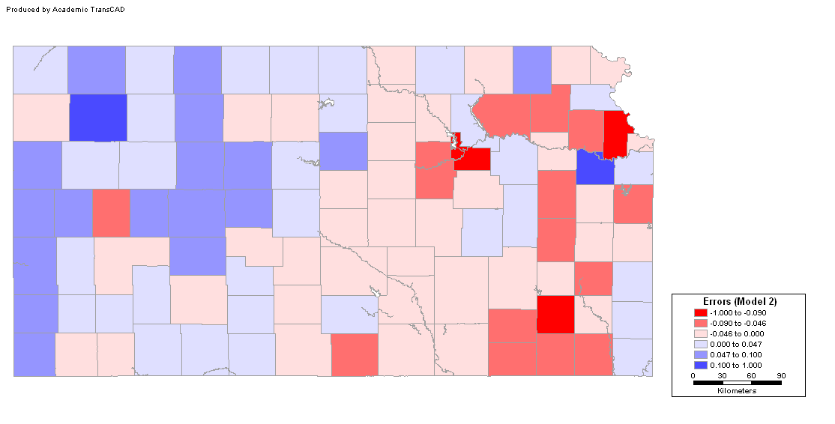
Analysis of Residuals
Are errors independent? Model 2

Slide 30
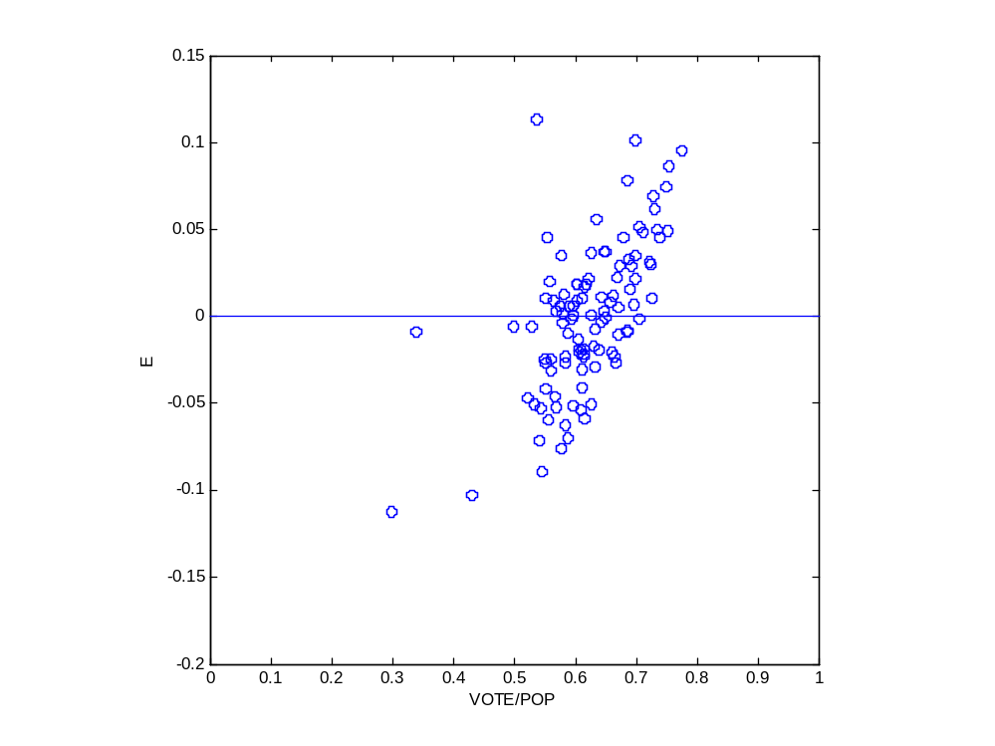
Analysis of Residuals
Is variance constant?
  Scatterplot of errors vs. variables

Slide 31
Analysis of Residuals
Are errors normally distributed?
  Histogram
  Probability plot
  Other tests (Jaques-Bera, Kolmogorov-Smirnov,Lilliefors)

Slide 32
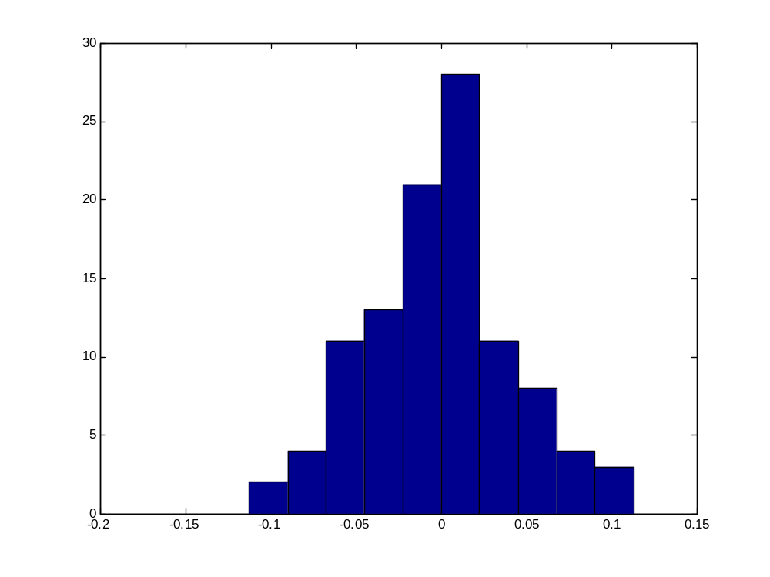
Analysis of Residuals
Histogram

Slide 33
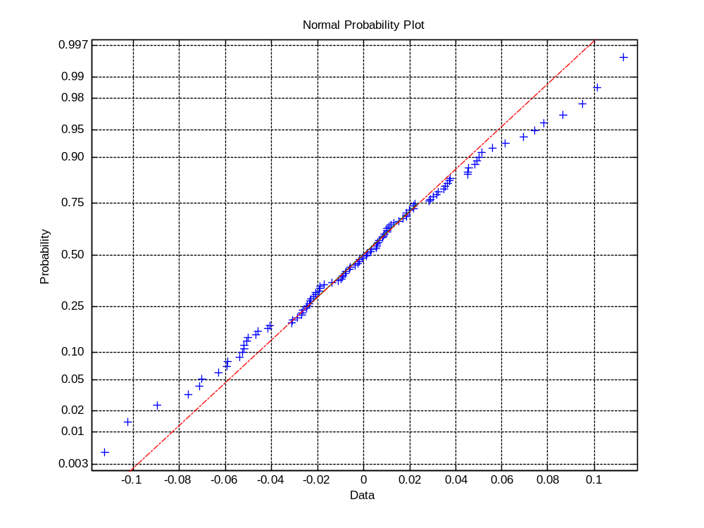
Analysis of Residuals
Probability plot

Slide 34
Analysis of Residuals
Other tests
  Test Normal?
  Jaques-Bera YES
  Kolmogorov-Smirnov YES
  Lilliefors YES .

Slide 35
Conclusion
The autocorrelated errors model is the best alternative
  Satisfies all major assumptions
  Accounts for all systematic spatial variation

Slide 36
Next…
Area data IIII
  Spatial regression models
  The role of theory

